Slide 1
Part 1: overview
Principal Component Analysis (PCA)
Partial Least Squares (PLS)
Two-way Orthogonal PLS (O2PLS)
Group sparse O2PLS
Feature/group selection
Number of groups to select
Post-hoc analyses using external databases
Notes:
Theory 5 – 10 min
Data

Slide 2
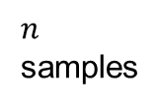




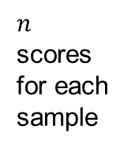


Recall: joint principal components
Reducing the number of variables $p$ by constructing a few latent variables
The loading matrix $W$ contains weights for all the $p$ CpG sites
Indicate relative importance
$p$ CpG sites
$$W$$
$$X$$
$p$ weights for each CpG site
$$T$$
$n$ scores for each sample
$n$ samples
×
=
Notes:
With o2pls, we have loadings and scores. But the loadings involve everything. We want to select.

Slide 3


Feature selection
$$W$$
$$W$$
3322 CpG sites
Which CpG sites are relevant?
A large number of small loadings
Shrink small but non-zero loadings to 0
Features with a non-zero weight are selected
0.5
0.4
0.1
0.2
0.1
0.1
…
0.1
0.1
0.1
0.1
0.2
0.5
0.1
0.3
CpG
0.6
0.5
0
0.3
0
0
…
0
0
0
0
0
0.7
0
0.3
CpG
CpG
CpG
CpG

Slide 4


Group selection
$$W$$
$$W$$
External biological information on features
CpG grouped by targeted genes
Combined group effects
Shrink weights of the whole group to 0, if it has a small combined effect
Select relevant groups or genes
0.3
0.2
0.2
0.1
0.1
0.1
0.1
0.2
0.1
…
0.1
0.1
0.5
0.2
0.3
0.2
0.6
0.5
0.5
0
0
0
0
0.4
0.3
…
0
0
0
0
0
0
CpG
group
CpG
group
CpG
group
CpG
group
CpG
group
CpG
group
CpG
group

Slide 5
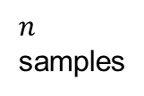


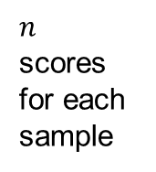
Dimension reduction + Group selection
The selection is performed simultaneously with the dimension reduction
How to estimate the sparse $W$?
$p$ CpG sites
$$W$$
Only non-zero weights for relevant CpG site
$n$ scores for each sample
$$X$$
$$T$$
$n$ samples
×
=

Slide 6
Penalty on loadings
The covariance becomes higher if more variables are added
The penalty balances between maximizing covariance and reducing number of variables
Less overfitting
More interpretable model
O2PLS part: maximizing covariance between joint components
Penalty on loadings, making solution sparse

Slide 7
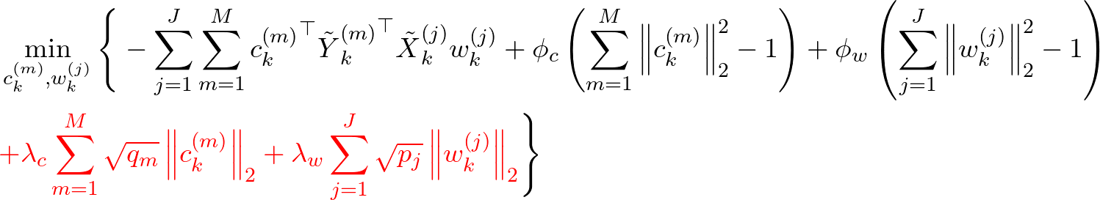
GO2PLS – different penalties
Feature selection by introducing L1 penalty (SO2PLS)
Group selection by introducing group-wise L2 penalties (GO2PLS)
Solved using (block) coordinate descent efficiently
Notes:
what lambda means

Slide 8

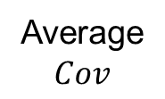



How to select the number of groups
Subjective approach
Arbitrary number of groups
Data-driven: Cross-validation
For each choice for the number of groups, evaluate performance:
Select the number of groups that yields the largest covariance
Split samples into
two subsets
1st
Validation | Training
$${Cov}_{1}$$
Repeat k times
(k-fold)
Training | Validation
Training | Validation | Training
$${Cov}_{2}$$
Average
$$Cov$$
2nd
…
Fit model
Evaluate covariance
$k$-th
Training | Validation
$${Cov}_{k}$$

Slide 9
Part 1: overview
Principal Component Analysis (PCA)
Partial Least Squares (PLS)
Two-way Orthogonal PLS (O2PLS)
Group sparse O2PLS
Feature/group selection
Number of groups to select
Post-hoc analyses using external databases
Notes:
Theory 5 – 10 min
Data

